Slide 1

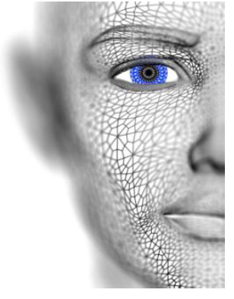
University of Missouri-Columbia - College of Engineering – Electrical Engineering and Computer Science Dept.
Localized Deep Learning Structure for The Large-Scale Biometric Data Recognition
PhD Candidate EECS
Adil Al-Azzawi
Adil Al-Azzawi

Slide 2
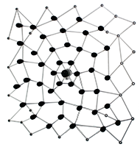
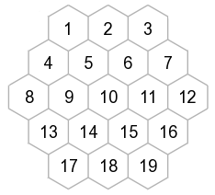
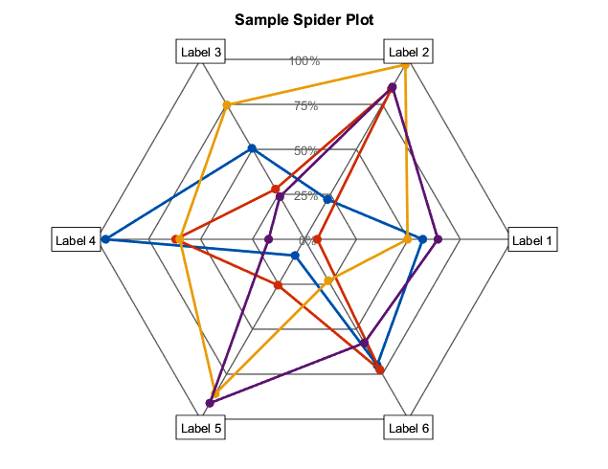
Circular Distribution
Approach : Spider-Web based Model (Heuristic Random Space Searching Approach and Data structure) for Biometric Fingerprint Identification
Distribution
Data strcuture
Searching Algorithm
In probability and statistics, a circular distribution or polar distribution is a probability distribution of a random variable whose values are angles, usually taken to be in the range of ) 0, 2π ) .
Adil Al-Azzawi

Slide 3
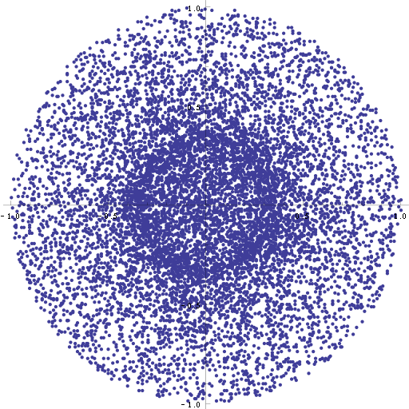
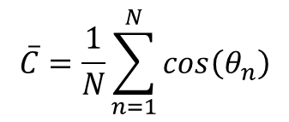
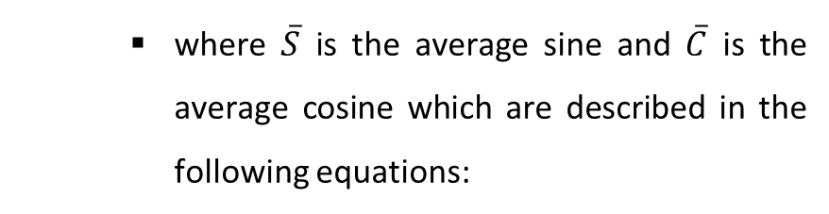

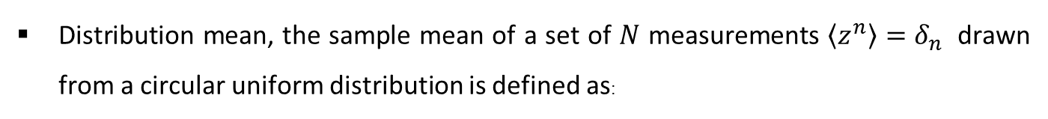


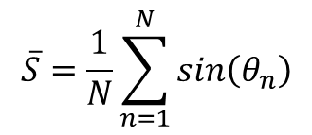
Circular Uniform Distribution (CUD)
Circular Uniform Distribution (CUD)
Distribution mean, the sample mean of a set of $N$ measurements $〈z^{n}〉=δ_{n}$ drawn from a circular uniform distribution is defined as:
where $\overline{S}$ is the average sine and $\overline{C}$ is the average cosine which are described in the following equations:
$$\overline{C}=\frac{1}{N}\sum_{n=1}^{N}{cos\left(θ_{n}\right)}$$
$$\overline{S}=\frac{1}{N}\sum_{n=1}^{N}{sin\left(θ_{n}\right)}$$
${\overline{R}}^{2}$is the average resultant length is:
$${\overline{R}}^{2}={\left|\overline{z}\right|}^{2}={\overline{C}}^{2}+{\overline{S}}^{2}$$
$$\overline{θ}=Agr\left(\overline{z}\right)$$
A 10,000-point Monte Carlo simulation of the distribution of the sample mean of a circular uniform distribution for N = 3.
Adil Al-Azzawi

Slide 4
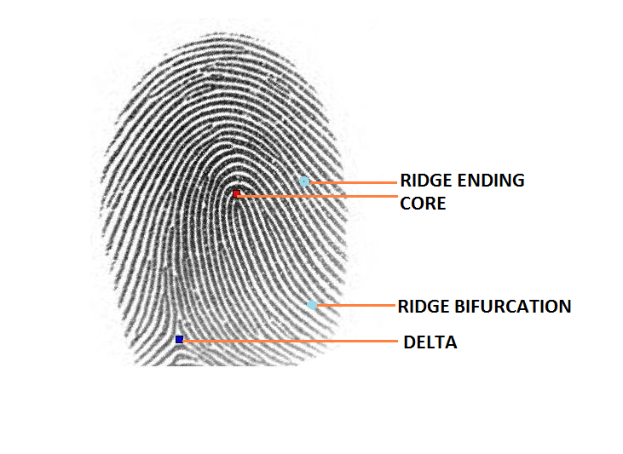
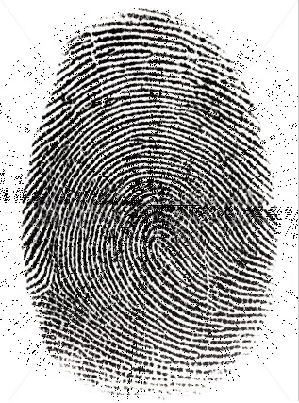
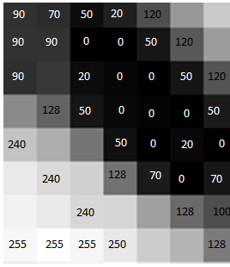
Implementation and Goal
Core point detection and 0 mean of the circular uniform distribution
CORE
Adil Al-Azzawi

